Slide 1


Electronics 1: Guitar Pedal Project
James Delaney & Hudson Bowen

Slide 2


Inspiration/Background
-Originally, I was not going to do a project as I couldn’t think of anything I wanted to do.
-Looked over and saw my guitar, project idea!
-Hudson and I decided to make an overdrive pedal, which features soft clipping at peaks to achieve a slightly distorted tone using an op amp and other circuitry techniques we learned in class.

Slide 3
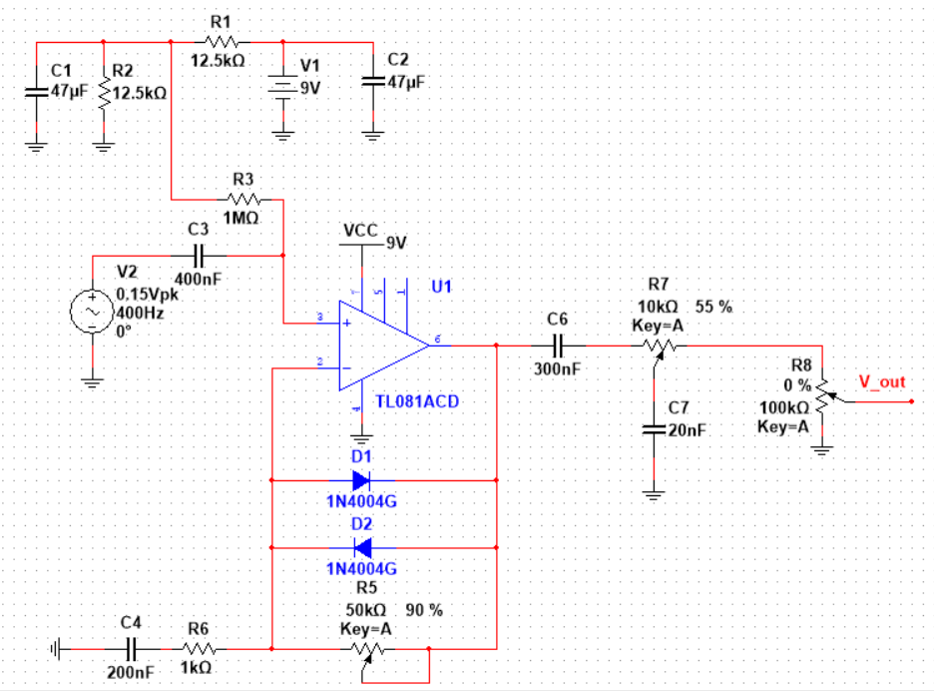
Circuit Overview
Three distinct sections
DC and AC inputs
Potentiometers and output
Feedback loop

Slide 4
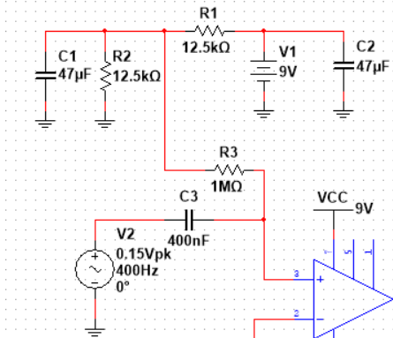
Circuit Analysis
DC Bias Voltage
DC Bias point achieved through voltage divider across R1 and R2
C2 removes AC noise from battery
AC Signal
C3 and R3 couple the AC and DC voltages
C1 removes any AC voltage above R3 by acting as a short for AC signal
Thus, our non-inverting input voltage is 4.5 V plus the input AC signal

Slide 5
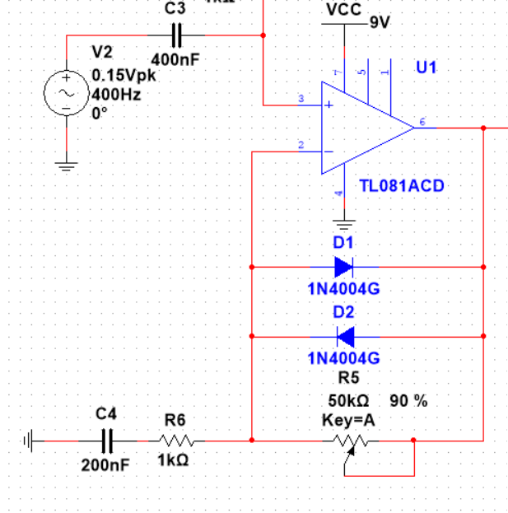
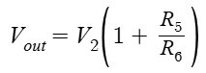
Circuit Analysis
Setup as a modified Non-Inverting Amplifier
Only AC Signal is amplified
C4 acts as an open circuit for DC signal, but a short for AC signal
When the diodes are off, the gain of the AC signal is:
However, when the output voltage’s magnitude is high enough, the diodes begin to conduct current
When this occurs, the output voltage needed to provide R6 with enough current to keep the inverting input decreases
This effectively lowers the gain of the amplifier, causing a “soft clip”

Slide 6
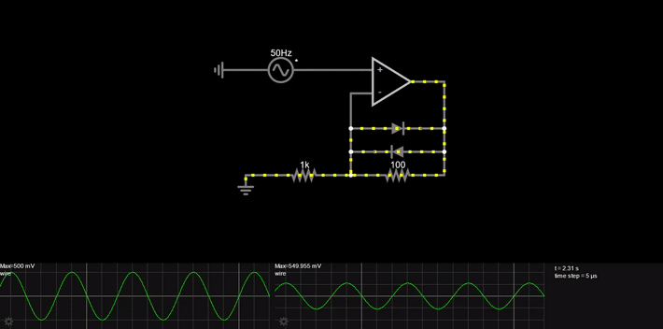
Circuit Analysis

Slide 7
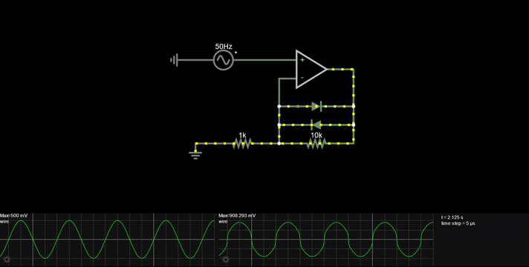
Circuit Analysis

Slide 8
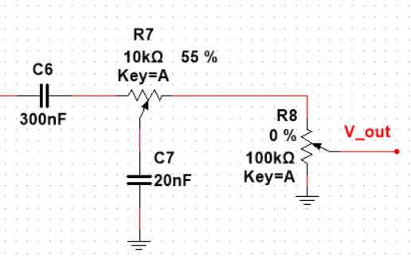
Circuit Analysis
Tone knob
C6 behaves as a decoupling capacitor to isolate our signal
R7 and C7 behave as a low pass filter, allowing tone control
R8 controls output amplitude (volume)
R8 needs to be much larger than R7 to better control volume
Voltage divider across R7 and R8
Volume knob

Slide 9
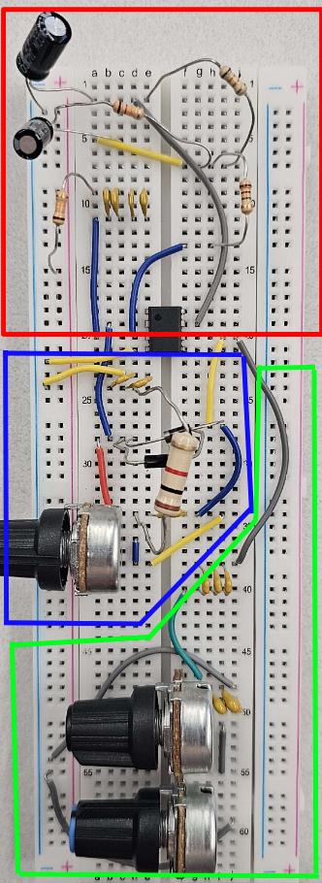
Practical Implementation

Slide 10
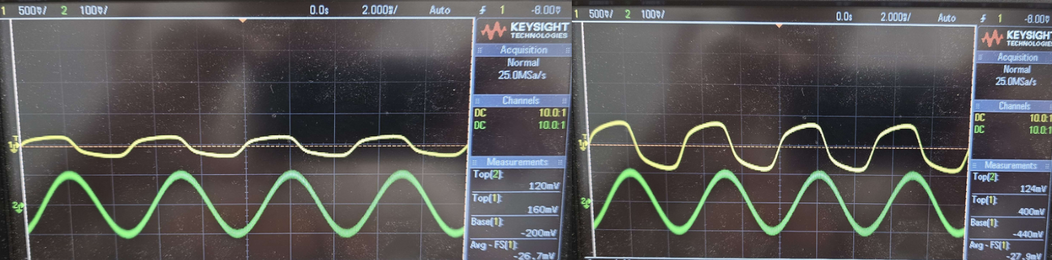
Results - Volume Knob
Yellow = output
Green = input
High Resistance
Low Resistance
Top(1) = 160mV
Base(1) = -200mV
Top(1) = 400mV
Base(1) = -440mV

Slide 11
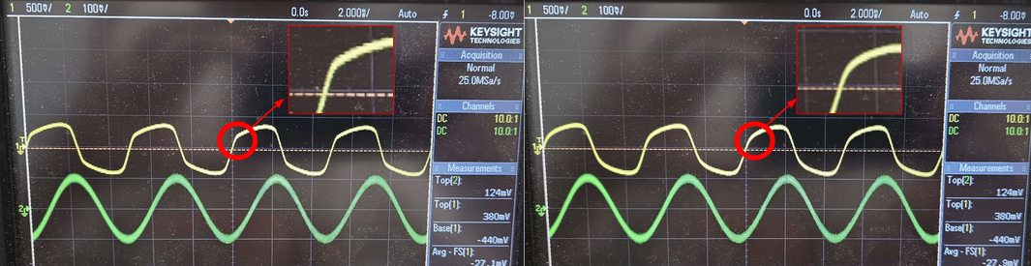
Results - Tone Knob
Yellow = output
Green = input
High Resistance
Low Resistance
Smoother rise in tone when turned down

Slide 12
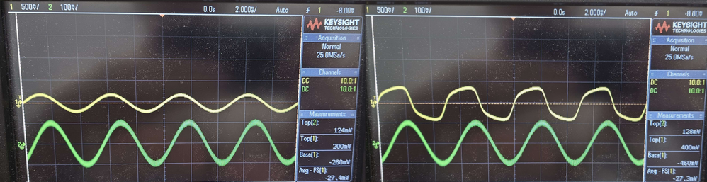
Results - Gain Knob
Yellow = output
Green = input
Low Resistance
High Resistance
From clean tone to distorted, clipped tone

Slide 13
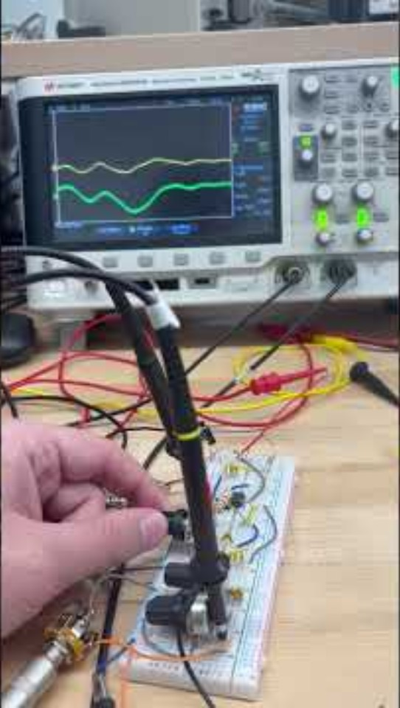
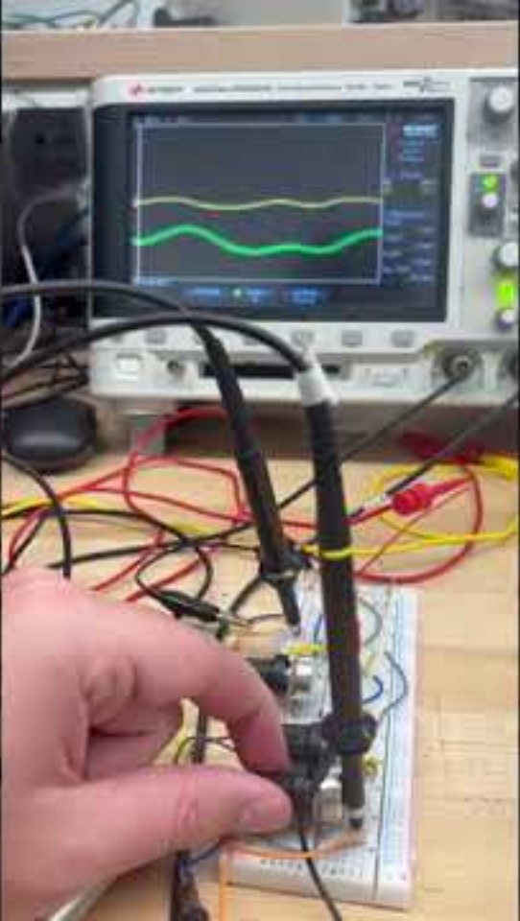
How does it affect the sound?
Volume knob
Gain knob

Slide 14
Thank You!
Q&A Time

